Slide 1
Bray Team Week 6 Update
Avery Haynes, Locke Lehmann, Travis Carlson, Cody Sims, Zachary Walker, Michael Hager
2/26/2024

Slide 2
Weekly Deliverables
Tasks | Lead | Percentage Done | Notes
Implement sensors into system | Zack/Locke/Cody | 50% | Inserted potentiometer into valve.
Purchase remaining parts | Avery | 100% | Strain Gauges purchased, awaiting arrival.
Wire sensors into DAQ and computer | Michael | 50% | Wired connections made for one deliverable.
Check on FEDC pressurized air availability | Travis | 100% | All parts purchased, awaiting arrival.
Write report and make midterm presentation | All | 100% | All finished, will turn in report tonight.

Slide 3
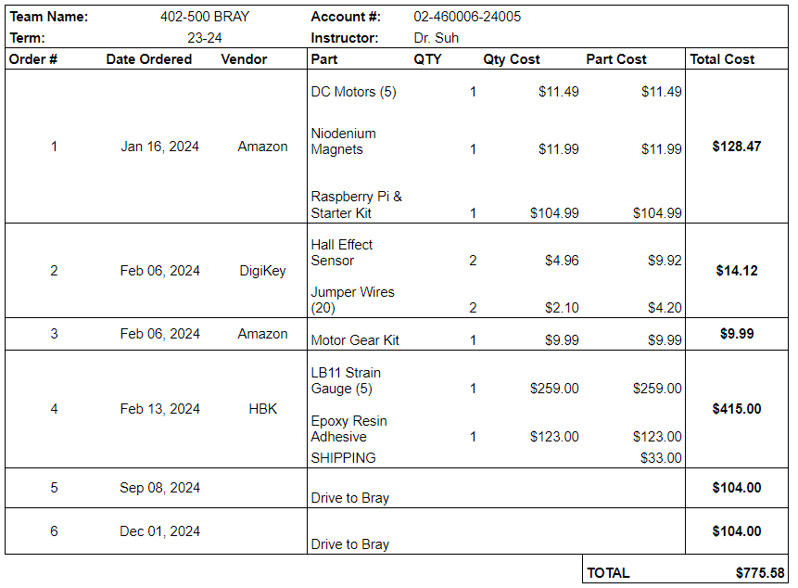
Purchasing Updates
Orders from Amazon & DigiKey (# 2, 3) arrived Friday, 2/23
Waiting on strain gauges and adhesive from HBK (# 4)
Need a solenoid valve & regulator to power the pneumatic actuator (received from Bray)
Waiting on A6 actuator & valve repair kit (received from Bray)
Budget Update: $775.58 spent (out of $3,803 approved)
Notes:
Done - Avery 2/18

Slide 4
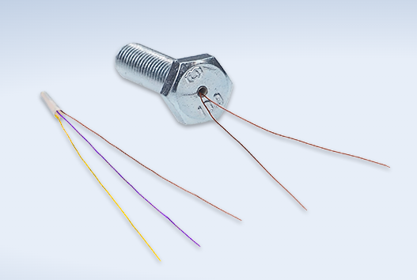
Strain Gauges
Ordered Cylindrical Strain gauges from HBK on 2/16
Using a resin epoxy to set them into S92 stop bolts, should be safe to cure in an oven (140 F)
2mm hole drilled into the bolt to a depth of maximum stress

Slide 5
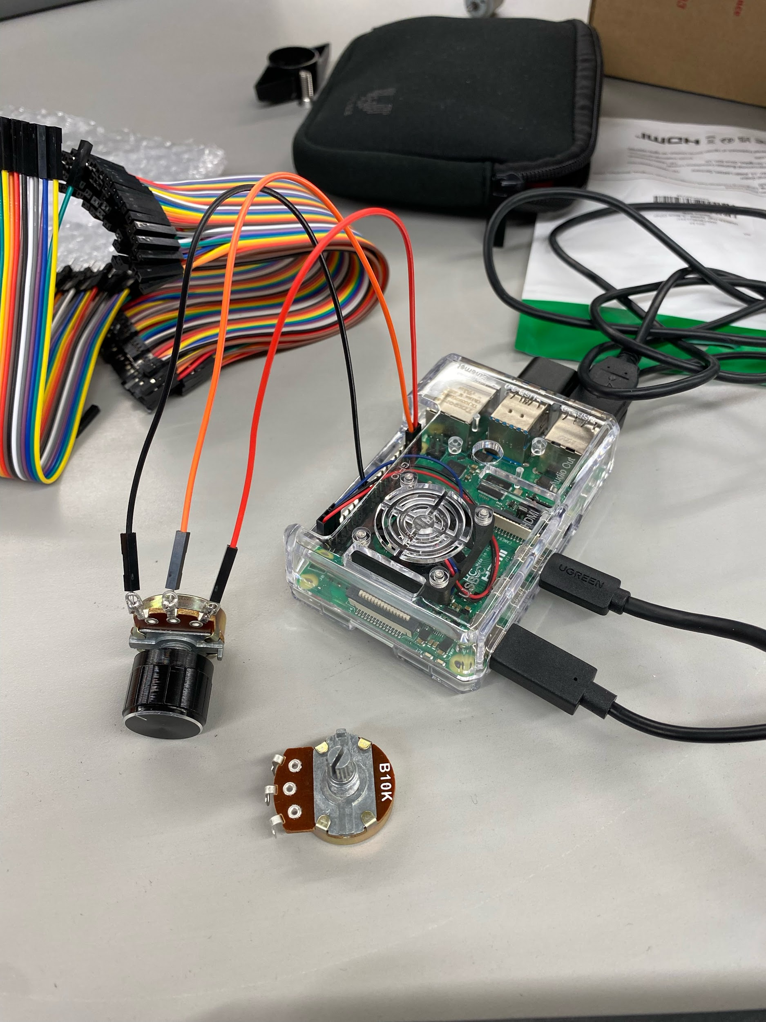
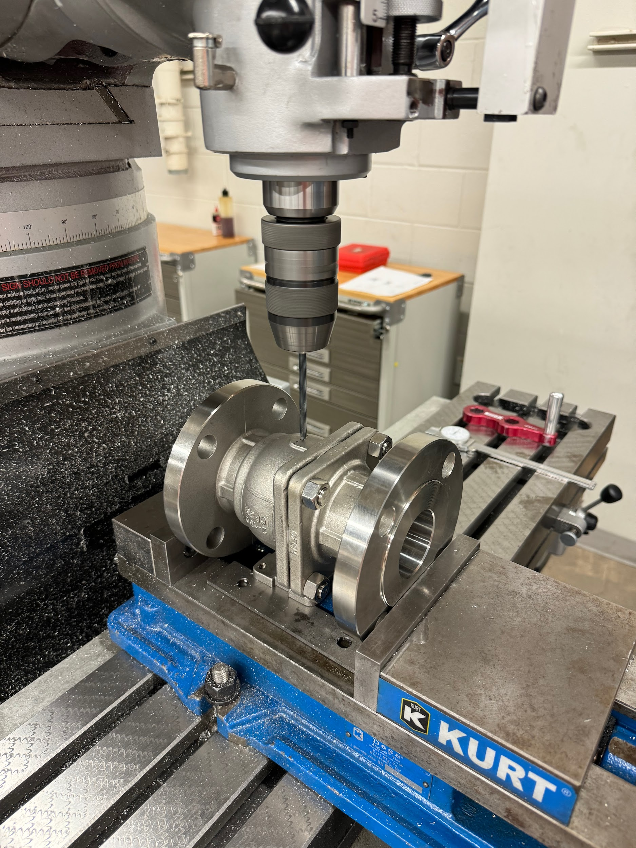
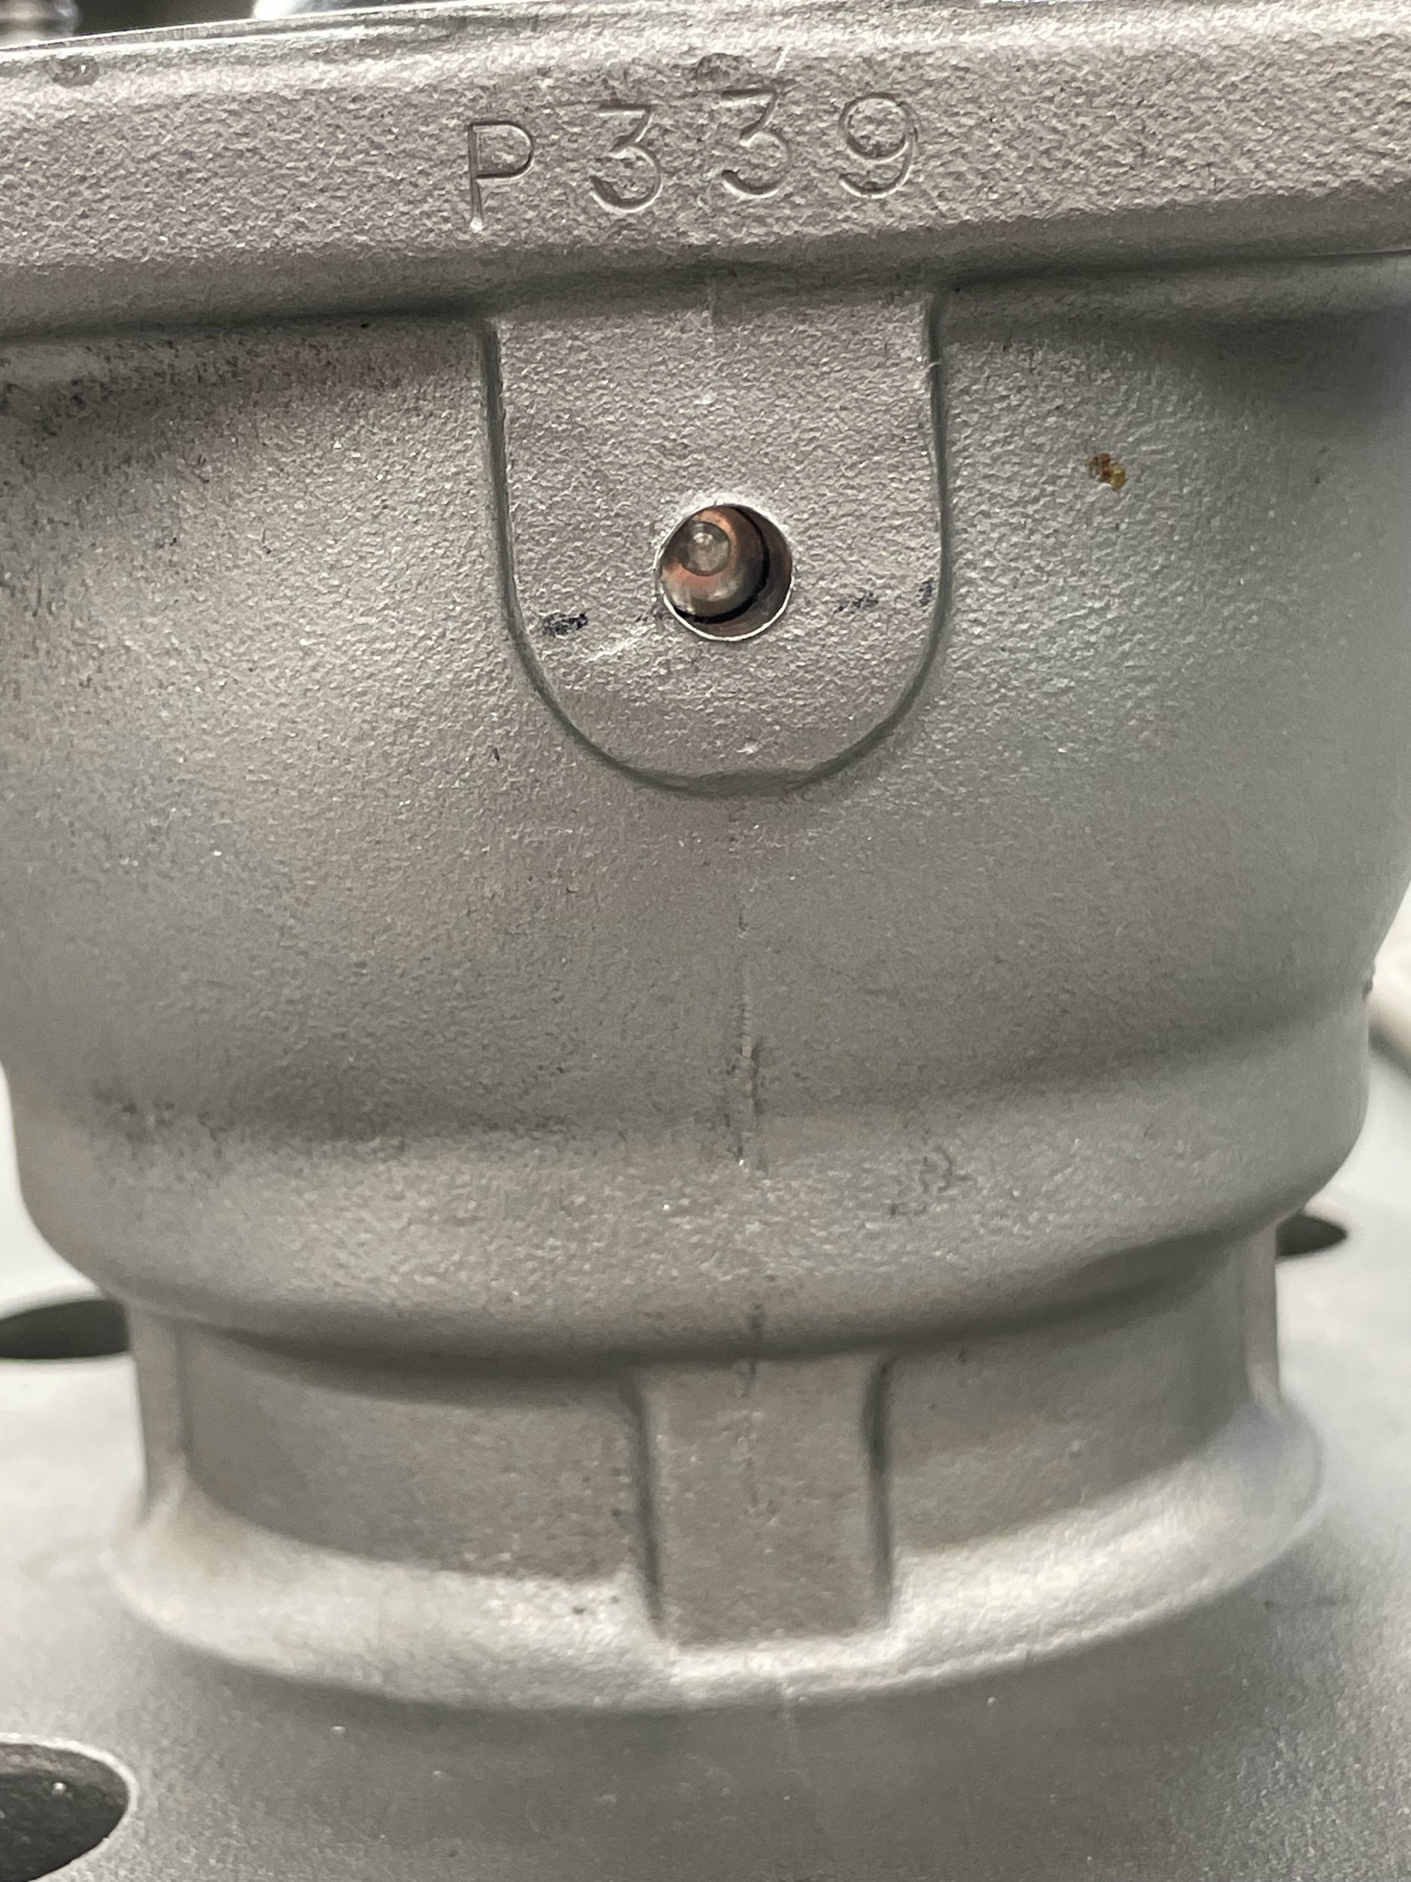
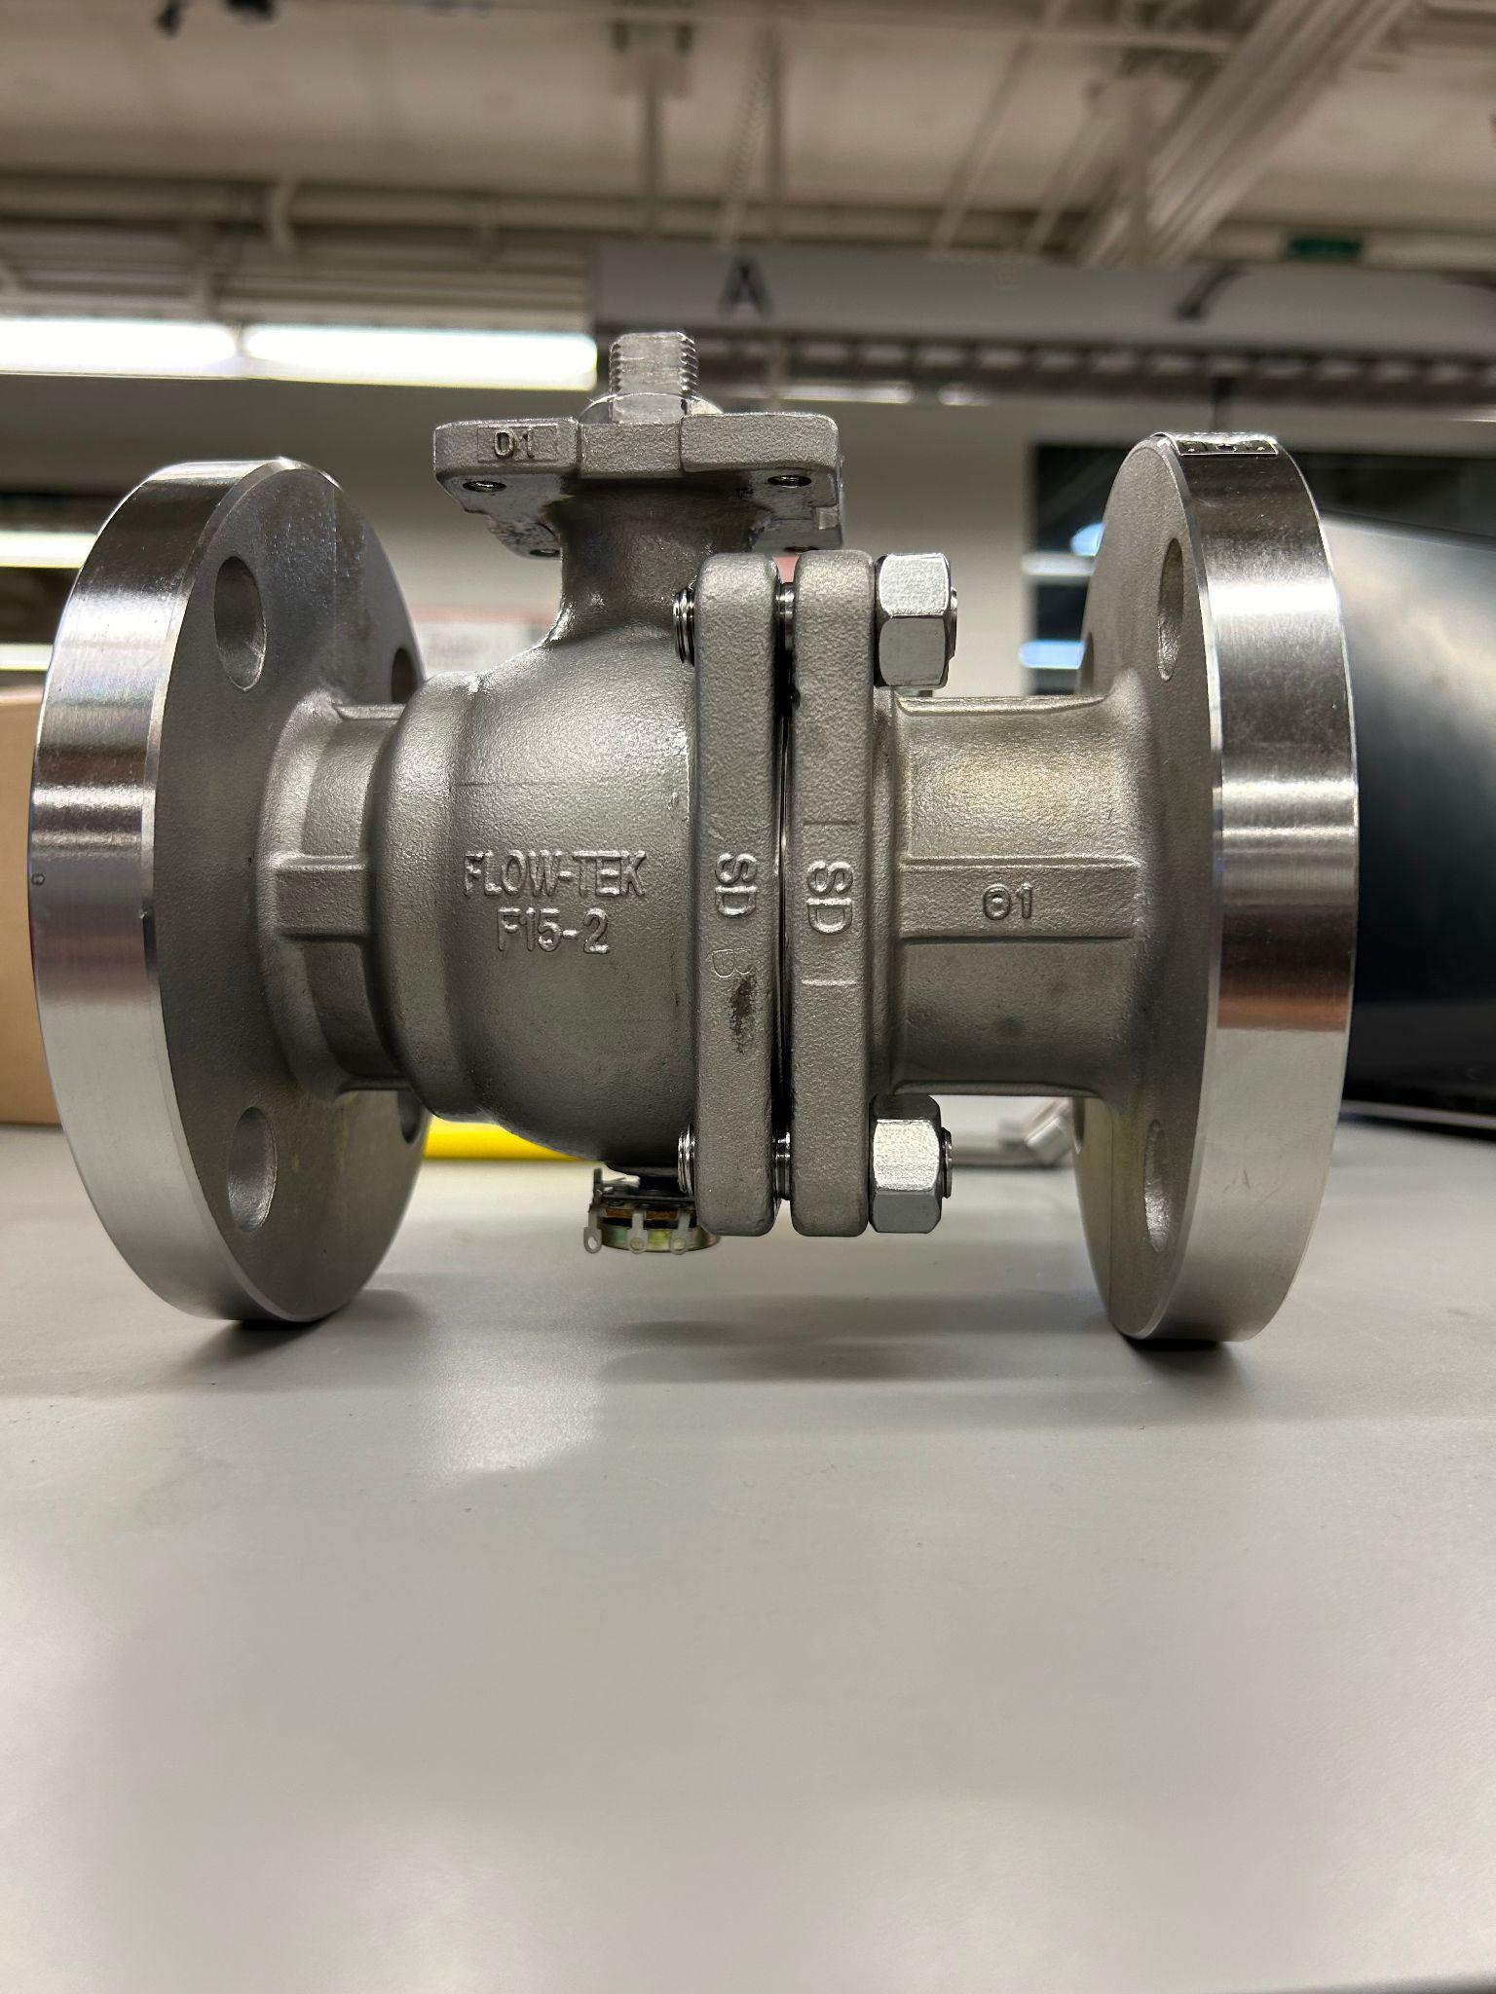
Potentiometer Status
Received potentiometers
Drilled hole in ball valve and inserted potentiometer
Attached potentiometer to Raspberry Pi
Notes:
Locke

Slide 6
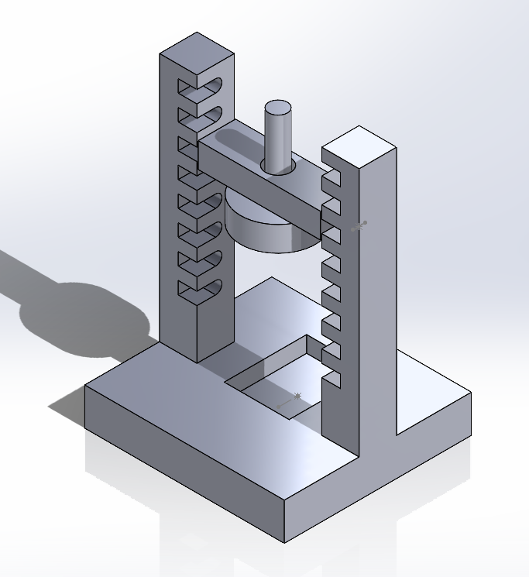
Hall effect sensor testing apparatus
Part modeled using the hall effect sensor schematics
Will insert the hall effect sensor in bottom slot.
Cylinder represents the rotation magnet.
Spacing is 2mm per slot with a max of 20 mm and a min of 0mm
Waiting to print assembly until dimensions can be verified with the part

Slide 7
Remaining Validation
Drill into stop bolts for strain gauges
Test Hall effect sensor, then insert into valve
Develop a way to firmly attach the electric motor to the actuator
Receive additional parts from Bray (in the mail) to use for testing and data collection

Slide 8
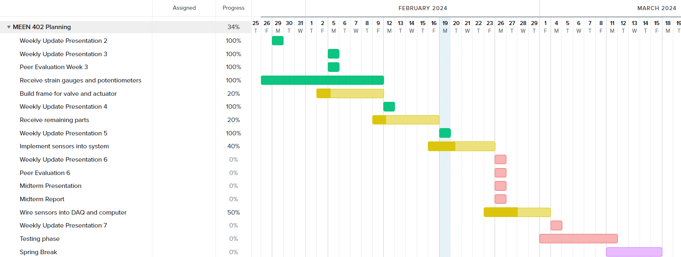
Gantt Chart

Slide 9
Next Week's Deliverables
Tasks | Lead | Percentage Done | Notes
Receive remaining parts | Avery | 50% | Awaiting arrival.
Build frame for valve and actuator | Cody/Travis | 50% | Made design.
Implement sensors into system | Zack | 50% | Need to drill into stop bolts.
Wire sensors into DAQ and computer | Michael | 50% | Wired connections made for one deliverable.

